Slide 1
Breaking Barriers : Why The Tech Industry Needs More Autistic Learners

Slide 2
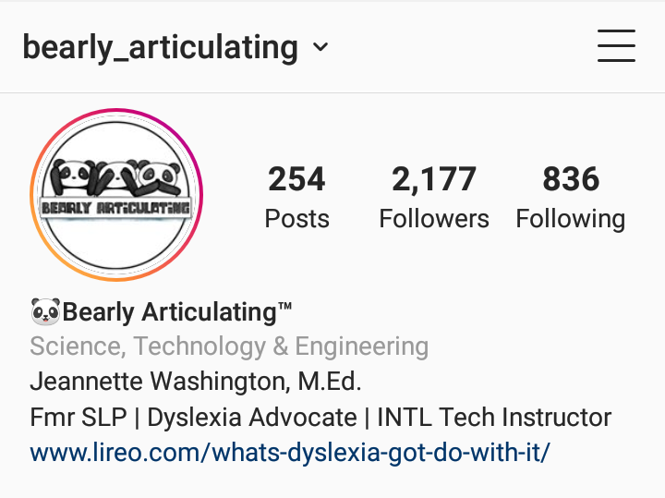
Tag, You’re It!
@gtbank
@BearlyArtic
_________________
#BeAVoice
#GTBAutism
_________________
View slides & follow along here: http://bit.ly/GTBAutism

Slide 3
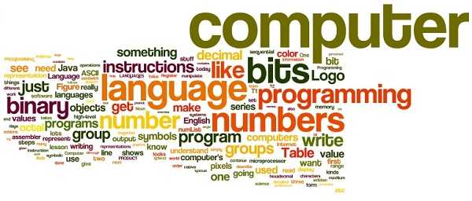
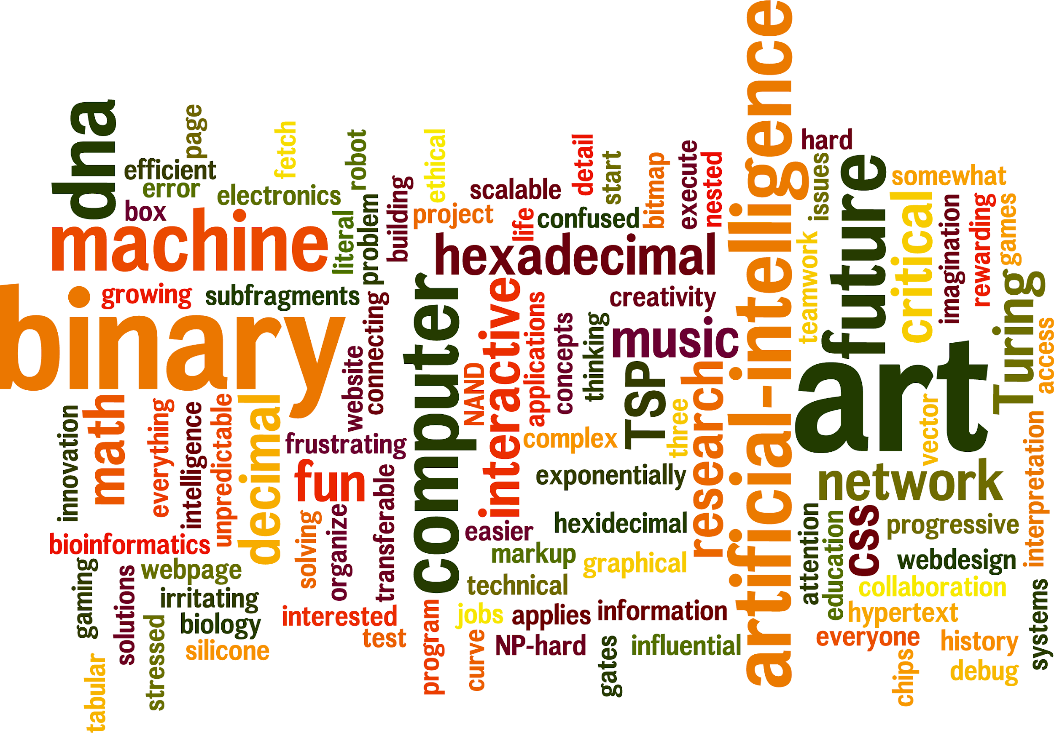

Slide 4
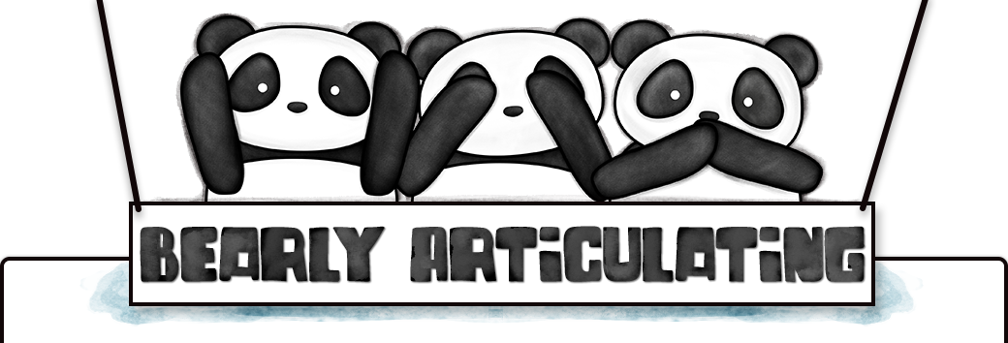
Breaking Barriers Expectations
Identify opportunities within the tech industry.
Learn what's being done to employ people with autism.
Twitter: @BearlyArtic | Facebook: Bearly Articulating | Instagram: Bearly_Articulating

Slide 5
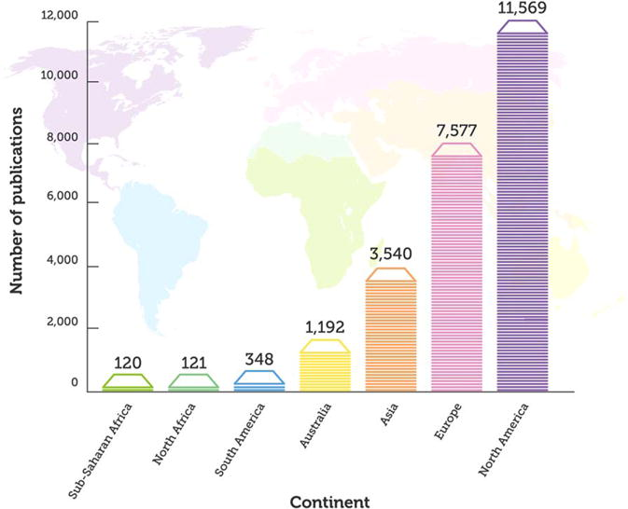

Slide 6
What We Know
According to Autism Speaks, autism, or autism spectrum disorder (ASD), refers to a broad range of conditions characterized by challenges with social skills, repetitive behaviors, speech and nonverbal communication.
One size doesn't fit all, but by providing an autism spectrum diagnosis with a functional level, at least in theory, it should be possible to draw a clear picture of an individual’s abilities and needs.
Twitter: @BearlyArtic | Facebook: Bearly Articulating | Instagram: Bearly_Articulating

Slide 11
70%
of adults with autism are either unemployed or underemployed.

Slide 13
34%
of students with an ASD that went to college choose to pursue a STEM major.

Slide 14
