Slide 1

PAULA HERRINGTON
CLASS, INC.
paula@classinc.net

Slide 2
STORY

Slide 3



Slide 4


Slide 5
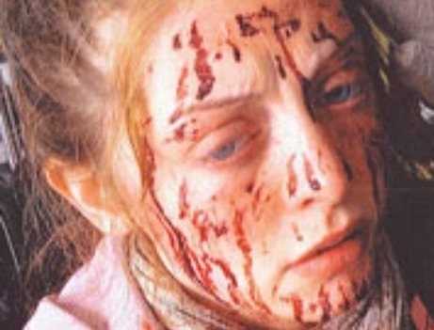

Slide 6
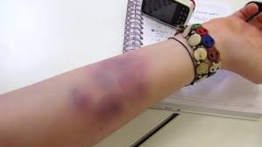

Slide 7
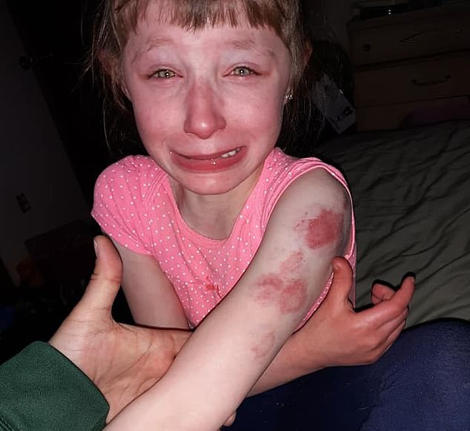

Slide 8


Slide 9

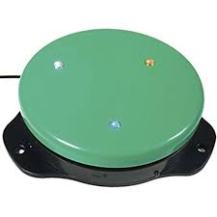



Slide 10
GO
STOP
FAST
SLOW

Slide 11
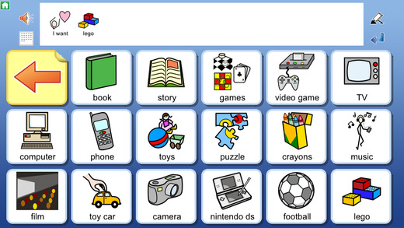

Slide 12
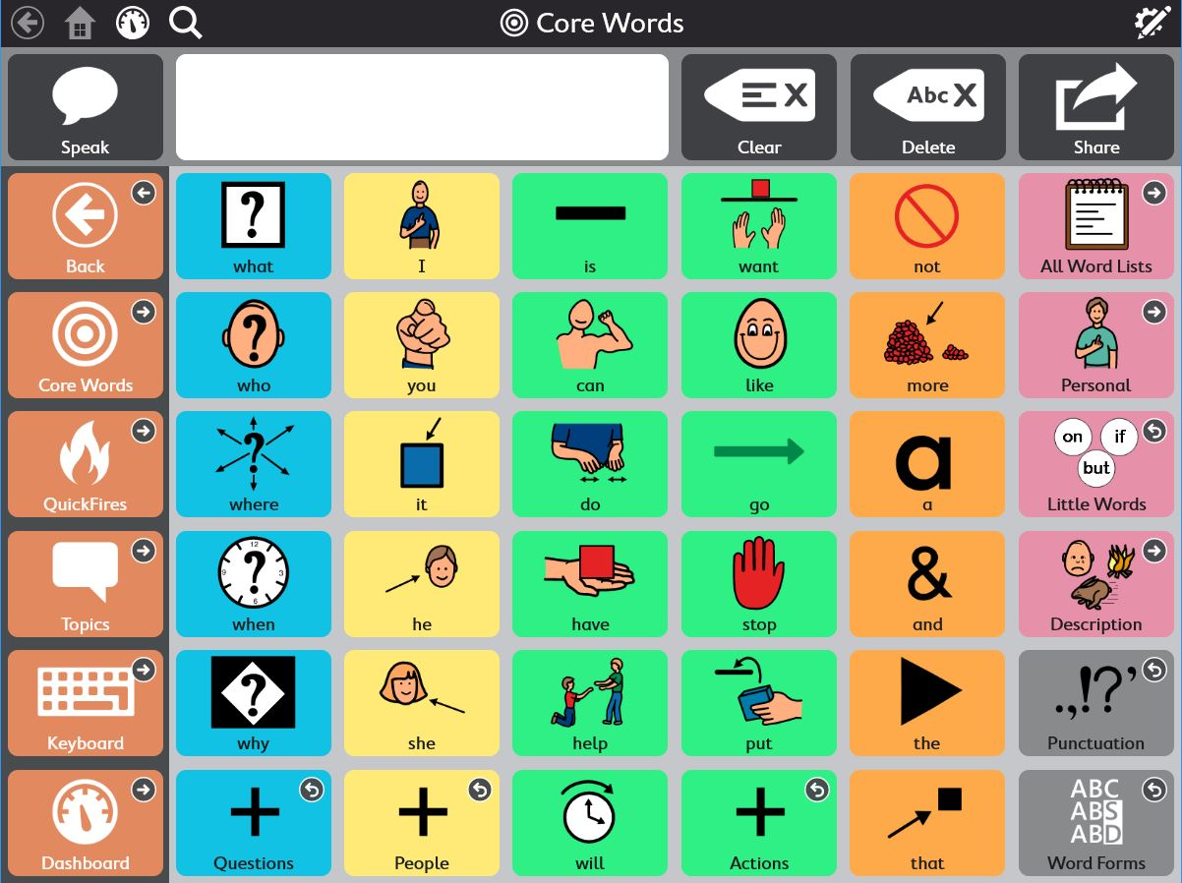

Slide 13


Slide 14
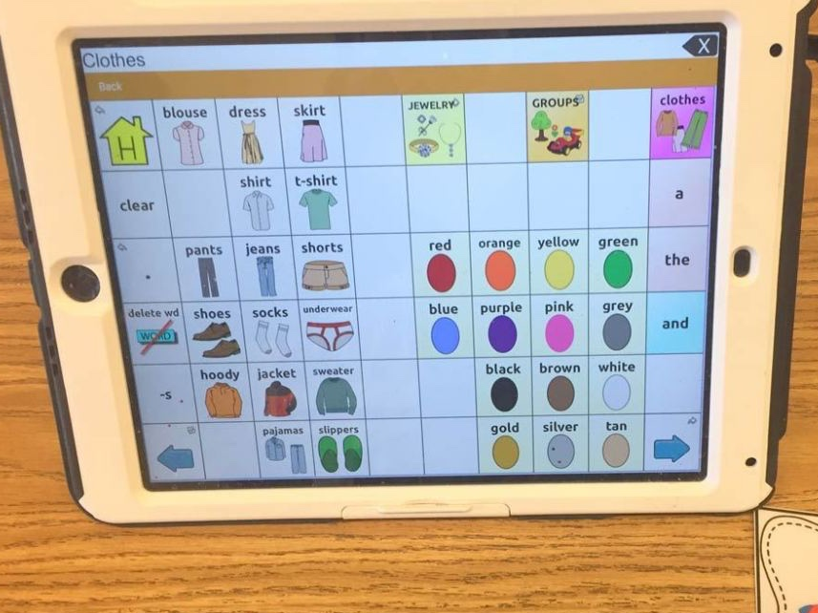

Slide 15
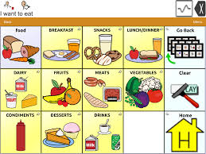

Slide 16


Slide 17
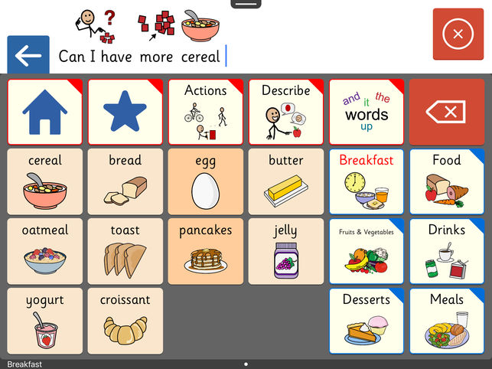

Slide 18
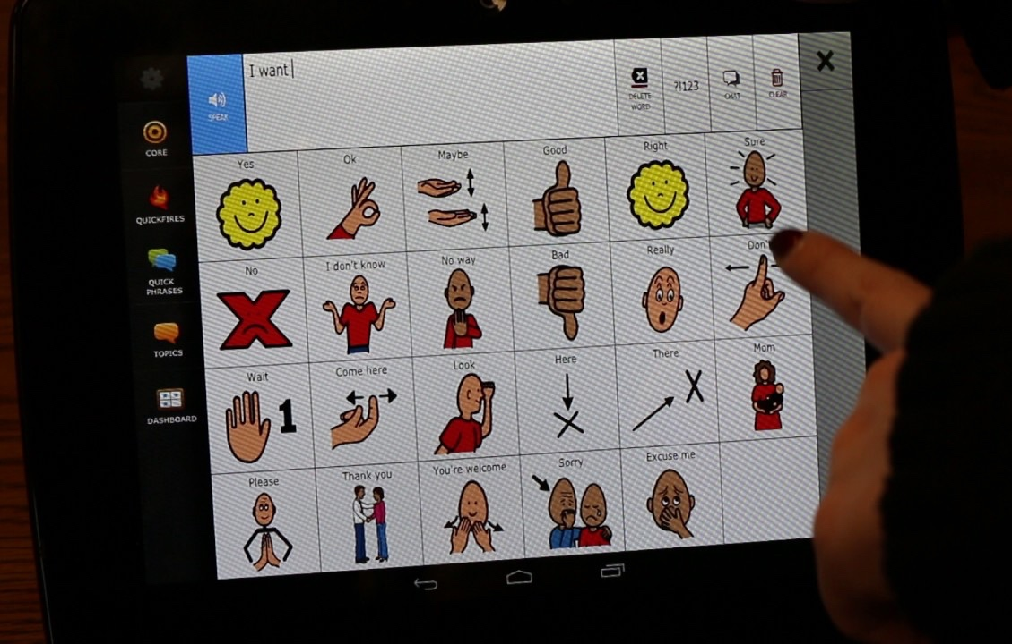

Slide 19



Slide 20
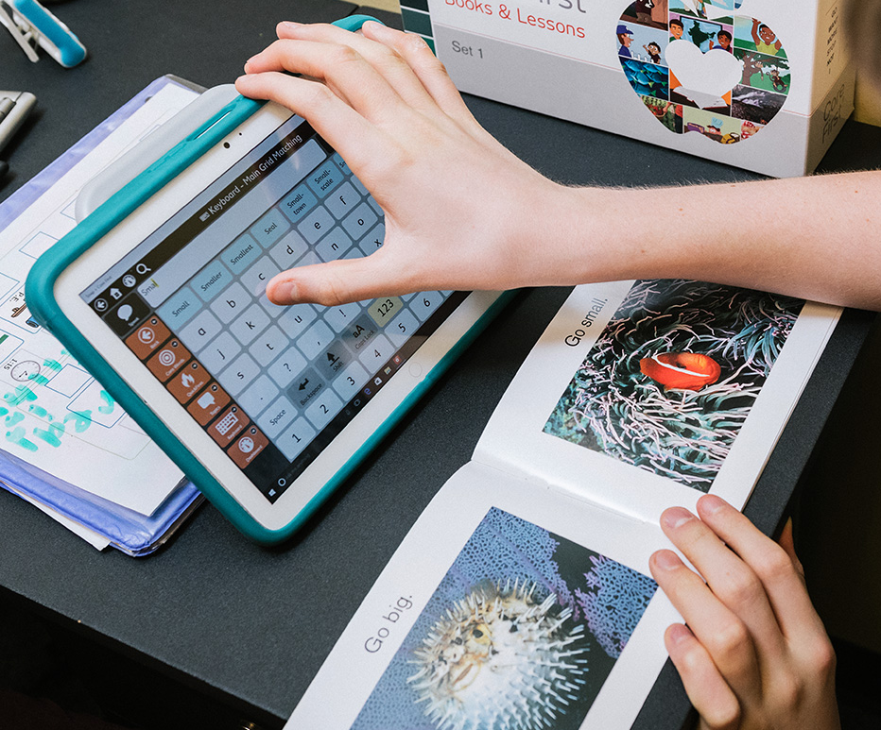

Slide 21
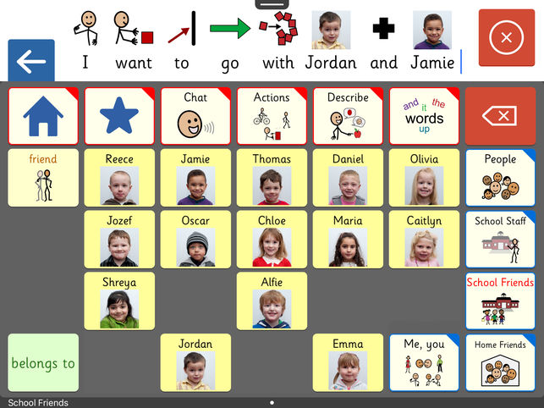

Slide 22


Slide 23
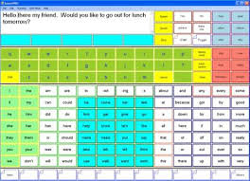

Slide 24


Slide 25
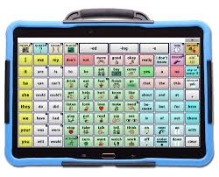

Slide 26



Slide 27


Slide 28
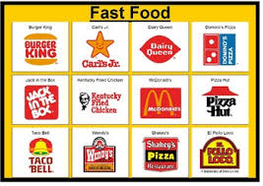

Slide 29









Slide 30


Slide 31





a
b
c

Slide 32



Slide 33

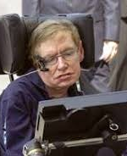

Slide 34

Thank you, GT Bank
For you generous support
of people with autism.

