Slide 1
The iPad
Modern day baby sitter or beneficial tool?
Tomi Agboola – Odeleye
Speech and Language Therapist

Slide 2
What is Assistive Technology?
Assistive technology (AT) is “any kind of technology that can be used to enhance the functional independence of a person with a disability.”^{[1]}
Assistive technology is anything that helps you do something that you couldn’t do before.
[1] The family Center on Technology and Disability Fact Sheet: Assistive Technology 101

Slide 3
Assistive Technology Devices
We tend to think of these tools as advanced, high-tech electronics. However, these tools are on a continuum, ranging from high-tech tools (such as electronics and computers) to low-tech tools (such as pencil grips and highlighters).
AT devices are “tools to help to overcome challenges and enable people living with disabilities to enhance their quality of life and lead more independent lives.”

Slide 4
There’s an app for that.
Increasingly, apps for the iPhone, iPad, Android, or other smart phones or tablets are showing up that enhance and ease every day life functioning; these include apps to assist people with disabilities.
These apps range from simple and free apps to help teach spelling, to advanced and often expensive apps that function as Augmented and Alternative Communication devices.

Slide 5
There’s an app for that.
Apps may be especially relevant to helping students with disabilities learn: students with autism or ADHD may benefit from the use of novel and stimulating technology, and students with physical impairments may benefit from the ease of access to the apps.
AT apps are specifically designed to help improve every day life functioning and learning for students with disabilties.

Slide 6
Using tablets as Assistive Technology
Mobile Device Applications for Individuals with Disabilities

Slide 7
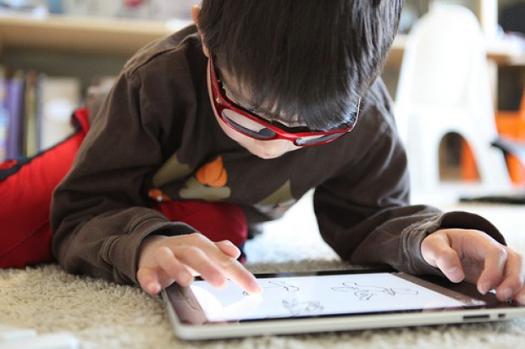
Cons
Distraction: overexposure?
Not for everyone?

Slide 8
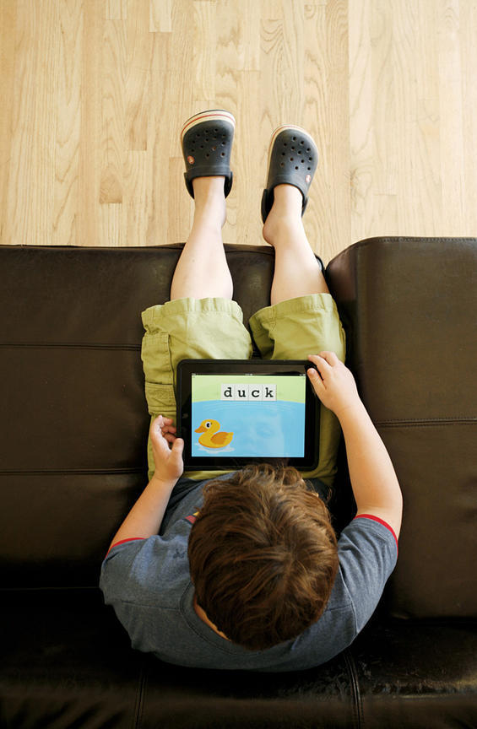
Pros
“It gives them the ability to control a piece of their environment and an opportunity to communicate.”
“Magical Device” - Steve Jobs
Beneficial for children and parents.

Slide 9
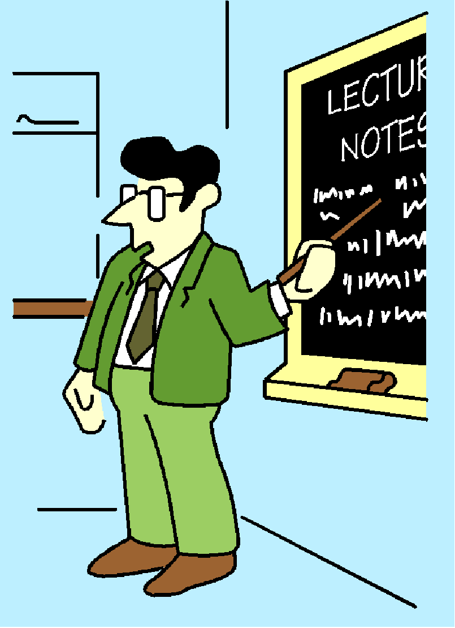
Autism and Communication
  DSM IV-TR includes qualitative impairments in communication as a defining feature of autism.
  Therefore, language based instruction can be problematic for students with ASD.

Slide 10
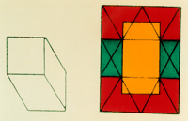
Visual Learners
Children with ASD have strong visual processing skills and usually have a heightened interest in visual materials (Furth, 1981).
Embedded Figures Task (EFT) has the subject find the simple shape embedded in the complex form.
Children with autism scored significantly higher than the controls on the EFT (Shah and Frith, 1983).

Slide 11

Interest in Multimedia
Many individuals with ASD are highly engaged and motivated by computers, video and related media (Shane & Albert, 2008).
Students with autism scored higher rates of using non-social media than peers with mild learning disabilities and speech-language impairments (Mazurek et al., 2011).

Slide 12

Preferred Play
In a survey of 89 parents of children with ASD, Shane and Albert (2008) found that during leisure time, children with autism tended to engage in interaction with media, preferring that to other play activities.
Same study found that the children with ASD had a consistent preference for animation.

Slide 13

Computer-Aided Instruction (CAI)
CAI includes the use of computers to teach academic skills and to promote communication and language development (NPDC on ASD).
The National Professional Development Center for Autism Spectrum Disorders (NPDC on ASD) describes CAI as evidenced-based practice.

Slide 14
Attending
Students with ASD attended to computer generated directions 97% of the time, compared to attending only 62% of the time to a teacher directed lesson (Moore & Calvert, 2000).

Slide 15
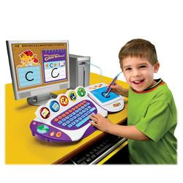
Acquisition of Skills
Participants with ASD, ranging in age from 7-11, who exhibited delays in all areas of academics, learned many new words and concepts from a computer based program (Bosseler & Massaro, 2003).

Slide 16
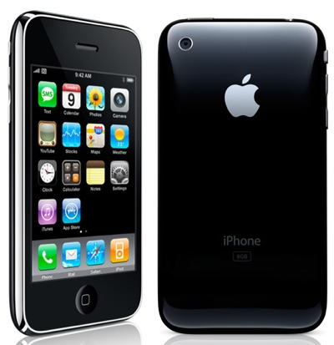
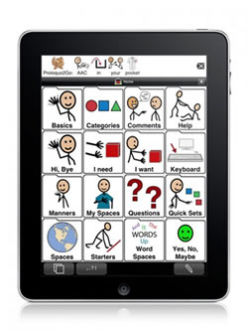
Assistive Technology & Apps

Slide 17


The first study
w/ iPads & Autistic children
Interview

Slide 18
Links to Lists of AT Apps for Individuals with Disabilities
Madalaine Pugliese composed this list of Apps into groups in accordance with the steps of the Stages© framework – she also describes how to select the right application for the individual child’s needs.
iPhone and iPod touch Apps for Special Education
App Gallery for noteworthy apps for individuals on the autism spectrum.
A collection of apps for special education.

Slide 19
Apple’s iTunes has a collection of apps for special education in its Apple Store.
These are sorted into the categories of:
Sign Language
Communication
Diagnostics & References
Emotional Development
Seeing & Hearing
Language Development
Literacy & Learning
Organization
Life Skills
All of these assistive technology apps help to further the functional independence of individuals in some way.

Slide 20
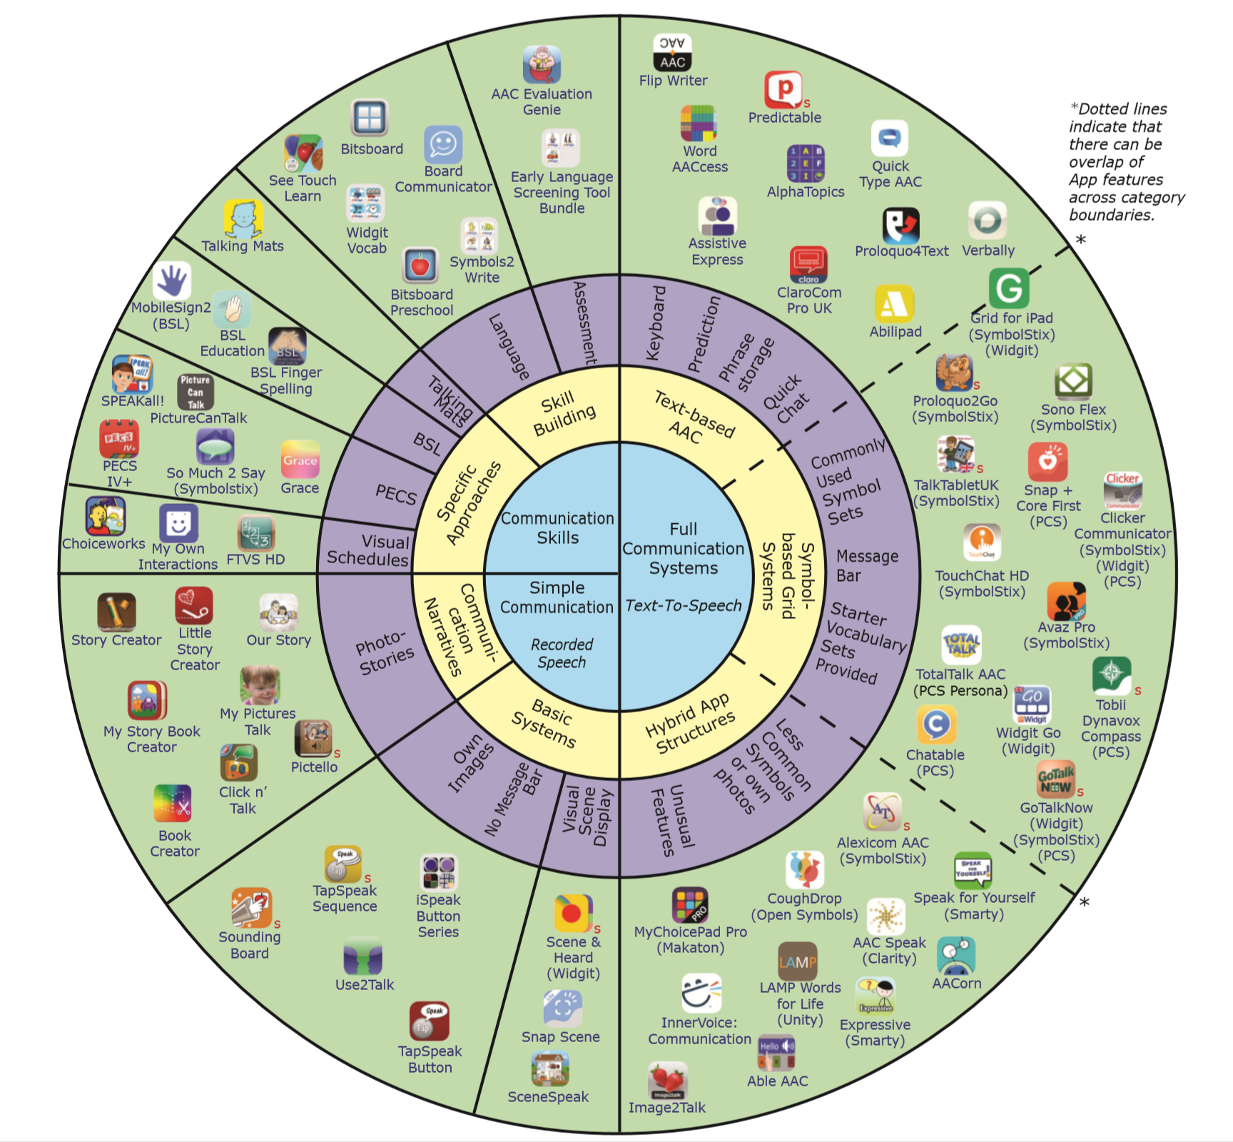

Slide 21


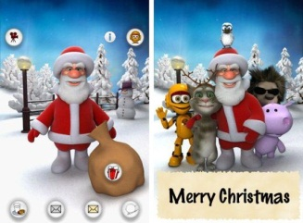

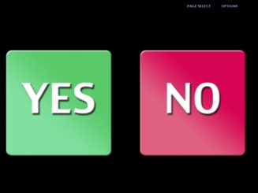
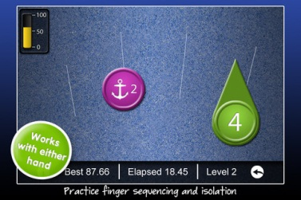
Remember . . .
There are thousands of apps available, these are just some examples.
All learners will have preferences for different apps. Make sure you test to see which app is motivating!!!

Slide 22
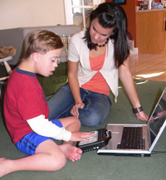
Recommendations
Always start with an AAC evaluation!
The iPad may not be an appropriate communication device for everyone.
You also need to know which communication app is the best fit for the child.

Slide 23
Communication
The act or process of using words, sounds, signs, symbols, or behaviors to express or exchange information or to express your ideas, thoughts, feelings, etc., to someone else
Four purposes of human communication
"AAC Myths Revealed." DynaVox. N.p., n.d. Web. 27 Mar. 2014.

Slide 24
What is meant by expressive and receptive language?
Receptive- more than just what you hear, it’s what you .
Expressive- more than just what you say, it’s you say it.
  Word choice, word order, word endings, tone, gestures
  Also different when writing
"What Are Expressive and Receptive Language Skills?" Dynavox, AAC 101. N.p., Sept. 2009. Web. 27 Mar. 2014
Notes:
AAC provides a means of demonstrating and utilizing expressive language and receptive language skills when speech is not functional in one or more environments. We usually think that people using AAC have difficulties with expressive language. But some have trouble with both types of language.

Slide 25
Characteristics of AAC Users
All age groups
Significant expressive language impairment
Impairment interferes with or prevents the development or use of oral language
Due to congenital or acquired disabilities
  Autism, CP, sensory impairments, ID, stroke, TBI, apraxia, ALS, MS, spinal injuries
Notes:
Augmentative and Alternative Communication can be used by individuals who are nonverbal, have poor speech intelligibility
and/or limited verbal expression. Individuals who are unable to use verbal speech for all of their communication needs may
require augmentative and alternative communication. Some deaf and/or hearing-impaired individuals learn sign language as a
form of alternative communication. There are a variety of congenital or acquired impairments that can cause individuals to be
unable to speak or write without adaptive assistance. The most common congenital causes of such severe communication
disorders include autism, cerebral palsy, mental retardation, and developmental apraxia of speech. Acquired impairments that
most often result in the need for AAC assistance include amytrophic lateral sclerosis, multiple sclerosis, traumatic brain
injury, stroke and spinal cord injury.

Slide 26
A – A - C
Augmentative and Alternative Communication:
Refers to tools and techniques used to supplement communication for people who have difficulty communicating through speech or writing.
Includes unaided techniques (pointing, gestures), light technology (communication books and boards), and high tech (voice output devices and computers).

Slide 27




A - A - C
Communicating without speaking
Notes:
Includes all forms of communication tools and techniques (other than oral speech) that are used to express thoughts, needs, wants, and ideas.
We all use AAC when we make facial expressions or gestures, use symbols or pictures, or write.
All people, even those who speak, use different forms of AAC every day. These are unaided techniques.
Passing a note
Pointing to an umpronouncable item on a menu
Waving to a friend
Showing excitement when you get a gift

Slide 28



A - A - C
Augmentative- in addition to
Alternative- instead of
Symbols- stand for something else
"What Is a Symbol?" Dynavox, AAC 101. N.p., June 2008. Web. 27 Mar. 2014.
Notes:
We use gestures, pointing, words and pictures in the environment, facial expressions, body language, writing, and drawing instead of and in addition to speaking.
Augmentative communication uses symbols too, primarily written words, phrases, sentences, photographs, and line drawings.

Slide 29


Symbols
c l u d a n g l e
S - P - O - O - N
D O G
"What Is a Symbol?" Dynavox, AAC 101. N.p., June 2008. Web. 27 Mar. 2014.
Notes:
What does this symbol stand for? A spoon.
How about this one? These are letters that stand for the same thing.
What if everyone you knew called a spoon a cludangle. Instead of using a spoon to eat your soup, you used a cludangle. No one would say, the spoon goes on the right side of the plate. The cludangle goes on the right side of the plate. The word cludangle would still be the utensil that we use to eat soup.
The words that we say and write are examples of symbols.
The type of symbol chosen to stand for wards, phrases, or sentences for a specific individual is very important. Some symbols look more like what they stand for than others. Letters are the most abstract, followed by line drawings or clip art, which is very typical of many AAC systems. Photgraphs would be the most concrete.

Slide 30

Benefits of AAC
Can give a voice to those who have had difficulty communicating throughout their lives.
Can increase and levels in home, community, and work.
"Challenges of AAC." Dynavox, AAC 101. N.p., June 2008. Web. 27 Mar. 2014.
Notes:
It can be a wonderful thing.

Slide 31
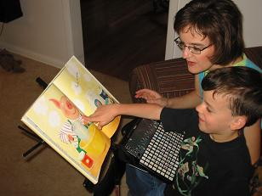
Benefits of AAC
Provides a means of expressing wants, needs, and ideas.
Decreases and .
Can help build communication and language skills.
Can increase interaction with family, friends and school.
"What Is AAC and Who Can Use It?" Dynavox, AAC 101. N.p., Sept. 2009. Web. 27 Mar. 2014.

Slide 32

Challenges of AAC
Takes time to learn system well.
Tool or device must always be available.
Often requires communication partners.
Changes and updates must be made to vocabulary.
Successful use of AAC depends on the person.
"Challenges of AAC." Dynavox, AAC 101. N.p., June 2008. Web. 27 Mar. 2014.
Notes:
Partners can help choose the right message, then need to respond to increase communication
The user must understand the symbols and know when to use them.

Slide 33

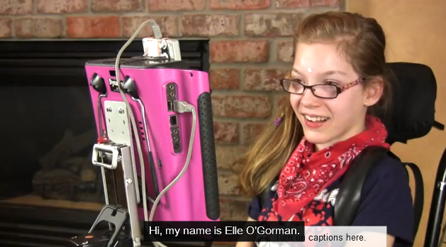
AAC in Action
http://youtu.be/R8VuA8yVBv8

Slide 34

An individual can be too cognitively impaired to benefit from AT.

Slide 35
Certain language skills appear in the absence of expected cognitive skills; infants.
Assuming incompetence leads to reduced opportunities and segregation.
The least dangerous assumption is a powerful tool.
Low tech solutions have been more readily used. High tech SGDs may have prerequisites that should be matched to skills.
Notes:
We don’t know what these individuals can learn but we do know that they will not learn if we do not teach them.
Least dangerous assumption- if no conclusive data is available, educational decisions should be based on assumptions that, even if incorrect, will not negatively impact the students’ ability to function independently as adults.

Slide 36
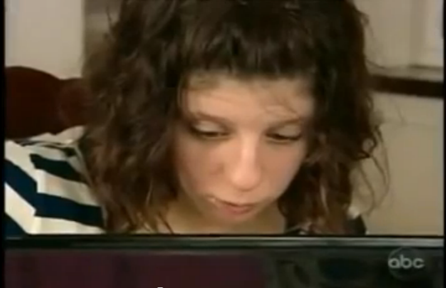
Carly’s Voice
Notes:
http://youtu.be/vNZVV4Ciccg

Slide 37

AAC is only used by people who cannot communicate verbally…

Slide 38
AAC can be used by a wide variety of communicators. We all augment our verbal communication with gestures, facial expressions and so forth.
AAC is useful for children with delayed speech development, and is becoming more commonly used with people who are learning a second language.
Notes:
Even an individual with a little speech can benefit from AAC.
Communication should be functional, even with unfamiliar partners.
AAC provides a means :
of communicating more understandably
expressing the exact message one wishes to express
communicating with greater independence
participating in longer interactions
expanding language and communication skills

Slide 39

The goal of communication is to express wants and
needs…

Slide 40

For most people, in most situations, expressing wants and needs is secondary to social expression.
One way to think of this is to put yourself into the position of the person who uses AAC. If you could only say three things, would they be “I need to go to the toilet”, “I’m hungry”, and “I’m thirsty”, or would they be “Hi, how are you”, “Can we talk?”, and “I love you”?
This is not to say that being able to control your environment is not important, but it may not be the most important (or motivating) thing.
Notes:
Maslow’s Hierarchy of Needs, 1943
Physiological or biological needs
Safety
Love, affection and belongingness
Esteem
Self-actualization

Slide 41

Using AAC/AT will delay speech development…

Slide 42

Studies show that the use of AAC actually improves speech development where possible (Silverman 1995), and it can be argued that it improves language development in all cases.
It should be noted that even the most sophisticated voice output communication aid cannot be as efficient or smooth as good speech.
Notes:
I hear things like:
“AAC will keep him from talking.”
“AA means we’re giving up on speech.”
“AAC will become a crutch. She won’t want to work on her speech anymore.”
“She’s too young. We need to give her more of a chance to use her speech before introducing AAC.”
Meta-analysis of previous studies of speech production before, during and after AAC intervention:
89% increase in speech production
11% no change
0% decrease in speech production
(Millar, Light & Schlosser 2006)

Slide 43

We should wait to use AAC until a person is ready for it…

Slide 44
Anybody can use AAC. We do not wait to communicate verbally with a typical child until they are ready to talk; rather, we surround them with a wealth of language.
The same can be said for a child who uses AAC. We should not wait to introduce other methods of communication until they are ready to use them; rather we should surround them with a wealth of language (verbal, gestural or symbolically based).
Notes:
How long will you wait?

Slide 45
“…breathing is the only prerequisite that is relevant to communication. Breathing equals life, and life equals communication. It is that simple.”
-Mirenda, 1993

Slide 46
AAC Considerations for a Young Child
Communication Needs
Notes:
Communication Needs- unaided, light tech or high tech
2. Size and Strength- can it be transported, can it be dropped or forgotten
Remember, children will grow in size and strength. We shouldn’t expect independence immediately, accommodations are easy in this area
3. Motor Skills- delays or impairments often are used as a reason to withhold AAC. For some, motor skills may not improve. We can provide assistance and accommodations with motor needs.
4. Vocabulary Representation- consider child’s abilities and input from family. Can you use actual objects to represent, photographs, drawings, symbols, words? No actual hierarchy exists. In the early stages of development, any symbol functions the same for the child regardless of iconicity, possibly because of the child’s limited knowledge of the actual referents.
5. Vocabulary Organization- grids, by categories, by context, in scenes?

Slide 47

We should not overwhelm somebody with access to too many symbols…

Slide 48
We should provide more symbols than a child can use at one time.
If we look at typically developing children, they have access to all the sounds of their language by 6 months of age. They use them appropriately when they are able to.
The same can be said for someone communicating with symbols. If a child is not provided with any more symbols than they have ‘mastery’ of, then they have no opportunity to practice new symbols in a natural progression.

Slide 49

Somebody who has a VOCA should use it all the time…

Slide 50
Voice output communication aids are often vital components of a person’s AAC system. It is true that they should have access to their device all the time (or almost all the time). But, there are times when it is not practical or necessary! (For example, using a VOCA in the bath is not usually a good idea.)
Communication is in its nature multi-modal; for example, there are many people who use VOCAs in most situations, but not at home with their family.

Slide 51

An AAC system should be a goal for all people who are nonverbal…

Slide 52
The ‘goal’ is to have functional communication. An AAC system may be a useful tool towards that end.
This distinction, while subtle, can help tremendously towards setting appropriate goals for a student.

Slide 53

‘Getting AAC Users
COMMUNICATING regardless of AAC system used
(no tech, low tech, high tech) or skill level!...’
Many thanks to Lauren Enders, ATC, Bucks County
Notes:
See handout!
POST in classroom!

Slide 54
DON’T
Expect a user to know how to communicate without direct models and instruction!
DO
MODEL, MODEL MODEL!!!
Model expected communication behaviors BEFORE expecting to see those behaviors from the user!!
Provide Aided Language Input!
Expect sentences right away!!

Slide 55

Normal Language Development
One goal of AAC intervention is to provide the child with normal language learning experiences, while gradually building up his/her vocabulary.
Normal language learning benchmarks are the best tools we currently have to determining how to direct the language learning experiences of children learning and expressing language through AAC strategies.
The long-range plan is to end up with a useful vocabulary of approximately 300+ core words on the child’s communication device.
‘Normal Language Development, Generative
Language and AAC’ by Gail Van Tatenhove

Slide 56
Augmented Language Input
“Aided language input (stimulation) is when a verbal communication partner highlights symbols on the user’s communication display as he or she interacts and communicates verbally with the user.”
  (Goossens’ et al., 1992)

Slide 57
Principles of Modeling
Modeling takes time, Time, TIME!
Modeling takes practice, Practice, PRACTICE!
  (And a high level of comfort with vocabulary!)
Always pair with speech
Model SLOWLY enough for the student to observe vocab selections and word combinations
Model maximum language possible without overwhelming the student
  1-2 words beyond student output level
  Base models upon target vocabulary in the lesson

Slide 58
When can I expect the student to use the words I have modeled?
How many models given before students started to use the words?
  Range = 20 – 100, Average = 47!
How many models before students started to use language structure?
  Question Phrase: Range = 25-150, Average = 92
  Noun Phrase: Range = 75-175, Average = 103
  Data from PDE Conference presentation by Gail Van Tatenhove, 2013.

Slide 59
DON’T
DO
Over prompt!
Follow a prompt hierarchy!

Slide 60
DON’T
DO
WAIT 10-20 seconds (with and expectant look) before re-prompting!
RE-PROMPT too quickly!
COUNT 1-2-3…in your head!

Slide 61
Modeling within a Prompt Hierarchy
(prompt only as much as the student needs to respond!)
Focus your attention on student. Pause.
Ask an OPEN ENDED question. Pause expectantly.
  “What would you like to do next?”
Give a partial prompt then pause expectantly.
  “Should we move to morning meeting or finish our art project?”
Request a response then pause expectantly
  “Tell me move or finish ”
Present a full model. Pause Expectantly.
  “I want finish work”
  When student responds, reflect what you heard and then model something they could add!
Prompt Hierarchy from: Environmental Communication Training, Dr. George Karlan

Slide 62
DON’T
DO
Provide CORE WORDS!!
Focus on vocabulary that won’t be functional/used tomorrow!!
Nouns, verbs and describing words!
Don’t provide ONLY Nouns

Slide 63
Core
vocabulary is a statistical concept related to overall word
frequency.
The most frequently occurring words (core words) = 80% of the actual words spoken
This 80% of the words we use daily come from a set of fewer than 350 -­ 400 words
The 50 most frequently occurring words account for 40-­50 % of total words said, while the 100 most frequently occurring = 60% of what is said
The most frequently occurring words for speakers is also true for users of AAC (when given access to these words in their AAC system)

Slide 64
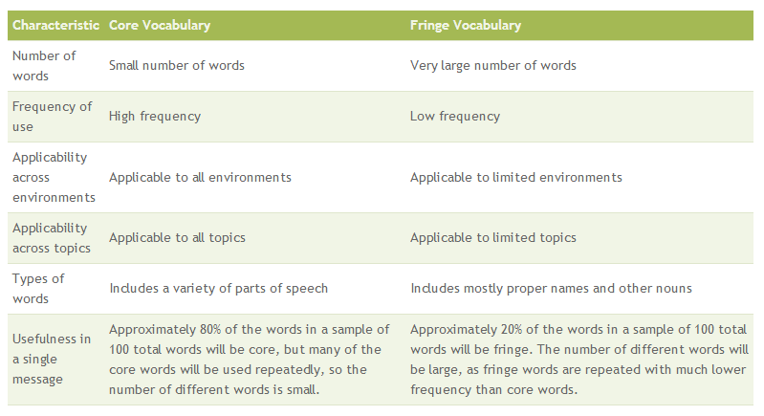

Slide 65
Core Words – Top 60!
Again feel mine stop
All get more tell
All done go my that
All gone good not there
Away happy now thing
Bad he off this
Big help on turn
Busy here out up
Come I play want
Different in put what
Do it question where
Don’t like ready who
Down little sad why
Drink make she you
Eat me some
Notes:
Picture Producers vs. non picture producers….

Slide 66
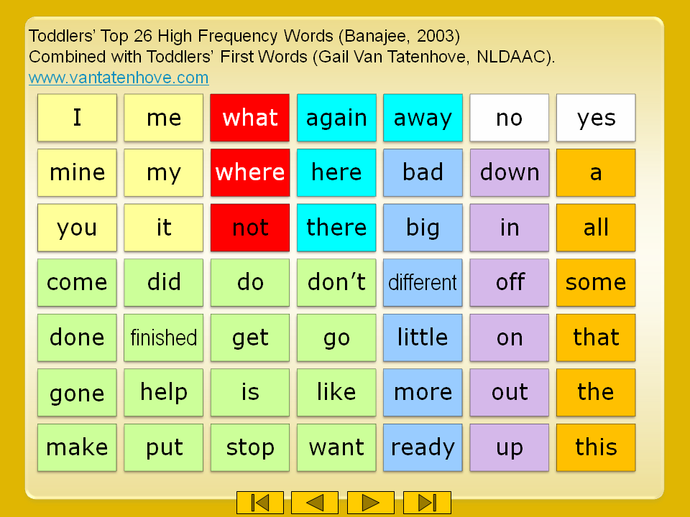

Partner Activity
Notes:
This is a list of 49 core words, selected from research on toddlers’ top frequency words. Look at these words. Many of these words can be put together to make phrases and sentences; for example, I don’t like that.
For the next 30 seconds call out as many phrases and sentences as you can put together using ONLY these high frequency core words. Your facilitator will now pause to allow you to identify as many words or phrases as you can.
Note to facilitators, below is a partial list of potential responses.
It did not come out
My (mine) is put away in a little
Make some
Make a little
Put it here, put it of, come make it stop
I ready go out.

Slide 67
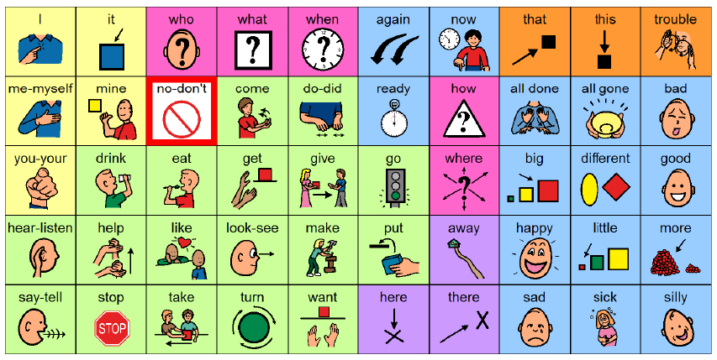
Core Board – First 50
(remake of core board from Pixon Project with BM symbols)

Slide 68
DON’T
DO
Teach all language functions including directing, commenting, requesting assistance, rejecting, etc…
Teach only requesting

Slide 69
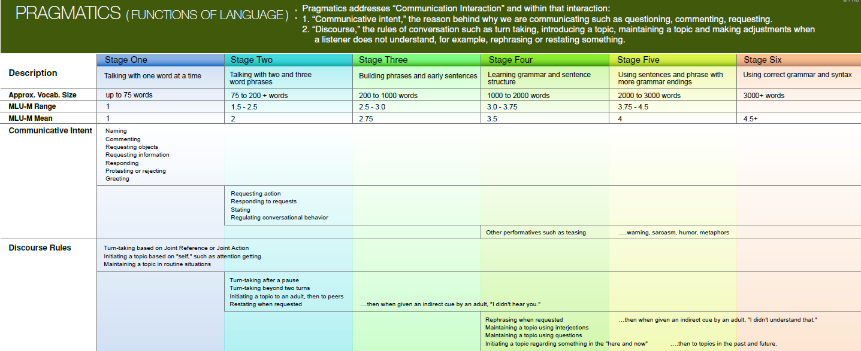

Pragmatic Language
http://www.aaclanguagelab.com/materials/AACPragmaticsChart.pdf
Notes:
Handout

Slide 70
DON’T
DO
KEEP icon placement consistent
MOVE SYMBOLS!
Keep repeated icons in the same location on each page/screen
Notes:
Discuss Automaticity…typing example
Doyle story….

Slide 71
DON’T
DO
ALLOW user time to explore and learn the system
Stop all ‘babbling’ (exploring, button pressing)
Notes:
Nancy – Jordan story

Slide 72
DON’T
DO
MAKE AAC available at all times!
Remove the device
Keep the AAC system in their desk, cubby or backpack!

Slide 73
DON’T
DO
DO ALL THE TALKING!!
PRESUME COMPETENCE!!

Slide 74
Examples
Of how you can use the iPad to support people with autism.

Slide 75
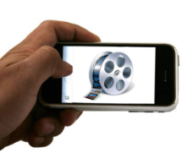
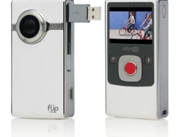
TEACHING BEHAVIOR & PROCEDURES
VIDEO MODELING
SELF MONITORING
Tape the whole class* & discuss what they see +/-
Tape an example and non-example to compare
Have the student and mentor watch the videos to compare
through self monitoring
*taping guidelines

Slide 76


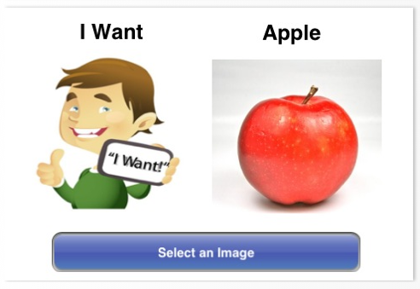
Communication Apps

Slide 77
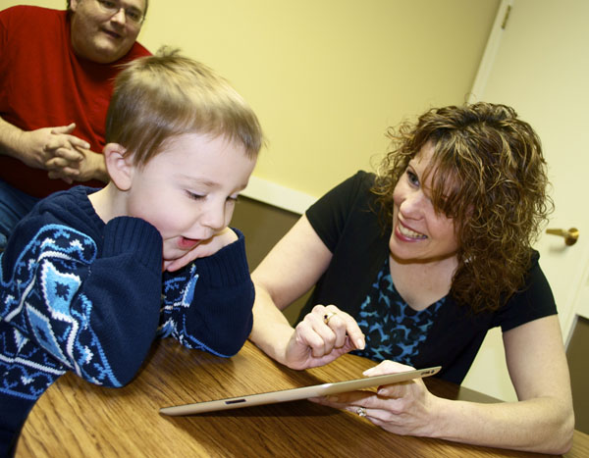
Teaching Communication
Find what objects/activities the child is highly motivated by.
Introduce the highest preferred object/activity on the iPad first.
Practice throughout the day by having the child request for the preferred object/activity repeatedly.

Slide 78

Manding

Slide 79

Communication Apps
So much 2 say is directed towards individuals with cognitive and language impairments. Simple to use.
AnswersYes/NoHD teaches yes/no.
Look2Learn uses pictures with voice output. Also allows you to record your own audio. Limited to 140 pictures.

Slide 80
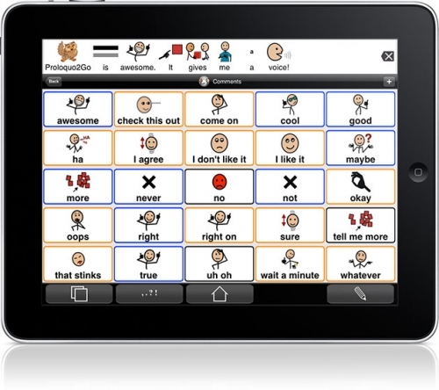
Communication Apps
Proloquo2Go allows you to add picture symbols or real photos to voice output words or sentences.
Speak it! Text to speech application for children that type.
Assistive chat text to speech application that has word prediction, 3 voices and adjustable volume and speed.

Slide 81
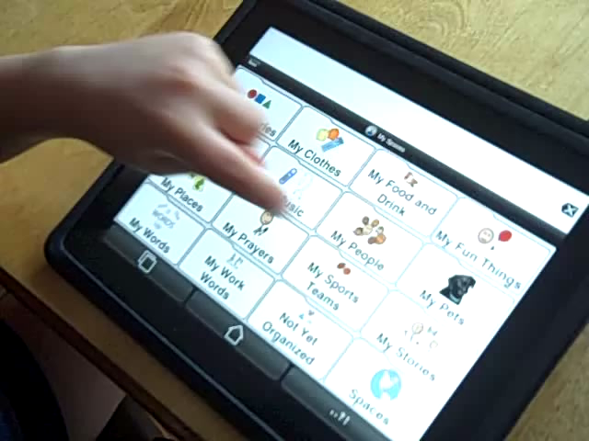
Proloquo2Go

Slide 82
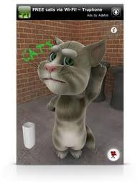

Communication Apps
Talking Tom group of apps reinforce expressive language.

Slide 83

Other Speech Apps
ArtikPix is an articulation app with flashcard and matching activities.
ABA Flashcards Actions includes 52 flashcards with clearly pronounced real audio and musical reinforcement.
Speech with Milo has an animated mouse perform over 100 actions.

Slide 84
Teaching Adjectives

Slide 85
Building Sentences with Verbs

Slide 86
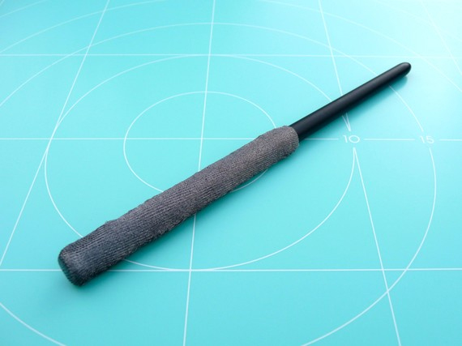
Teaching Motor Skills
Add tubing or sponge rollers to a stylus for a larger grip.
Stylus socks can be purchased for users that press hard.
Be creative! Find out which apps are reinforcing and make modifications to teach motor skills!

Slide 87

Motor Skills Apps
Touch trainer teaches training on how to touch and point to the iPad.
Hatch teaches pointing and cause and effect.
Bubble Snap can be used to teach pointing and tracing skills.

Slide 88

Motor Skills Apps
Dexteria is a set of hand exercises that improve fine motor skills.
iWriteWords has users trace numbers and letters to form words.
Letter Reflex teaches the learner how to overcome letter reversals.

Slide 89
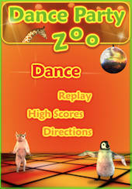

Motor Skills Apps
Dance Party Zoo is a dance game for practicing balance, rhythm and coordination.

Slide 90
Writing with Doodle Buddy

Slide 91
iWrite Words

Slide 92
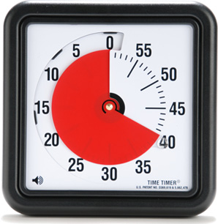
Behavior Apps
My Choice Board presents a visual display of choices.
Irewards is similar to a sticker chart.
Time Timer gives a visual display for how much time is left in an activity.

Slide 93
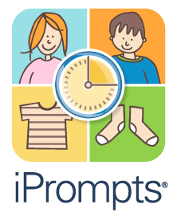
Behavior Apps
Choiceworks includes schedules (with timer), waiting, and feelings boards.
First/Then Schedule
iPrompts allows you to create schedules and provides a visual countdown for activities.

Slide 94
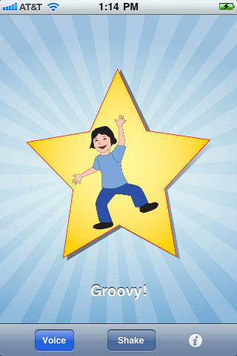
Behavior Apps
iEarnedThat turns a picture of a reward into a puzzle.
iPraiseU gives 100 positive statements for reinforcement.

Slide 95
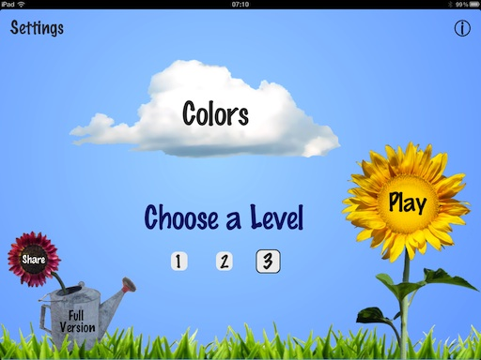
Academic Apps – Early Intervention
Monkey Preschool Lunchbox teaches about colors, letters, counting, shapes, sizes, matching, and differences.
Injini includes puzzles, tracing, farm games and more.
ColorSlapPs teaches color identificiation.

Slide 96

Reading Apps
Meegenius is a collection of over 300 children’s books that includes word highlighting and read-along technology.
PopOut!The Tale of Peter Rabbit is an interactive, read-along and word highlighting book.
Bob Books includes phonics based interactive games.

Slide 97

Math Apps
Toddler Counting teaches counting using 1:1 correspondence. Very reinforcing!
Monkey Math School Sunshine teaches sequencing, patterning, counting, adding and subtracting.

Slide 98
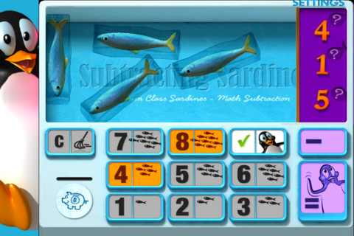
Maths Apps
Math Magic teaches addition, subtraction, multiplication and division with lots of positive reinforcement.
Adding Apples teaches simple addition problems with visual supports.
Subtracting Sardines teaches simple subtraction problems with visual supports.

Slide 99
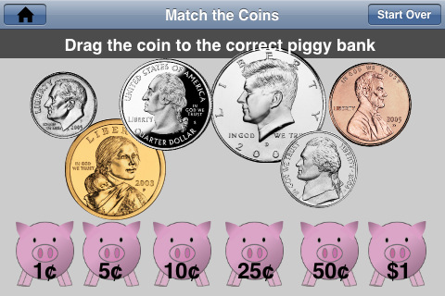
Math Apps
Cash Cow is a fun game about coins.
Coin Math teaches money skills ranging from matching coins to making change.
MakeChange has the learner use coins to make different amounts.

Slide 100

Khan Academy
http://www.khanacademy.org/
Mission of Khan Academy is to “provide a free world-class education to anyone, anywhere”
Provides video lessons on all subject areas.
KhanApp enables you to browse the Khan Academy curriculum.

Slide 101
Question Builder

Slide 102
Coin Math

Slide 103
Small Group Instruction with Academic Apps

Slide 104
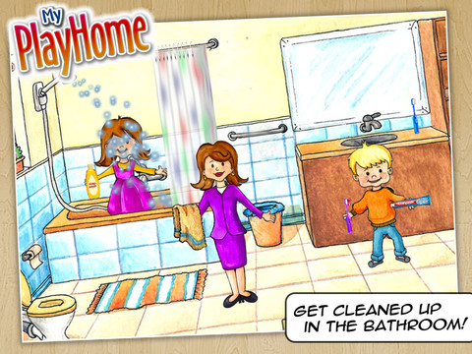
My PlayHome
“Navigate through different rooms of the house as your child makes different members of the family do things. The adult can give students directions or users can give each other directions, having family members do different things and manipulate objects in the house.”
Good to model for children appropriate behavior, life skills, and social stories. Fun and interactive to promote motivation!

Slide 105

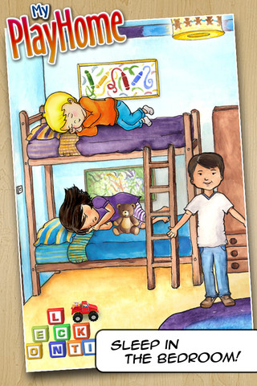
$3.99
By Shimon Young

Slide 106
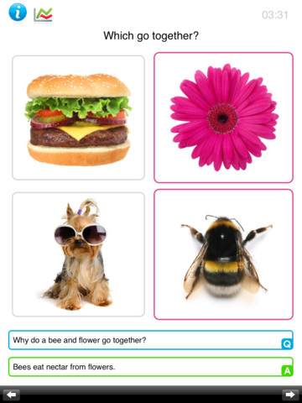
Which Go Together?
“Which Go Together?” is an ABA problem solving game to teach the skill of categorizing of items. The child problem solves and figures out which item goes together using bright and colorful images.
This app is “used by educators and speech language pathologists worldwide” and can assist in teaching students speech, language, and grouping and categorizing skills.
Real pictures are a fun stimulus for all children!

Slide 107
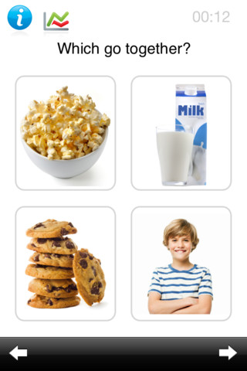
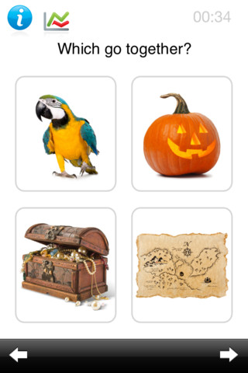
$1.99
By Kindergarten.com

Slide 108
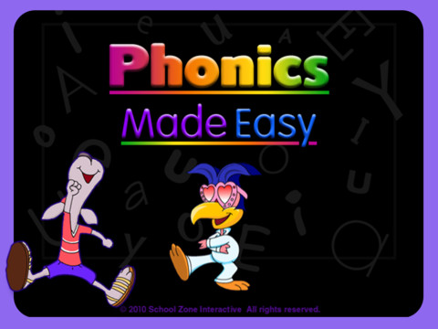
Phonics Made Easy
“Phonics Made Easy Flash Action iPad app has been developed to help children sharpen important phonics skills for reading success. Children will explore beginning and ending letter sounds, distinguish between long and short vowel sounds, pinpoint the rhyming families, work with letter blends, and more.”
Fun and interactive games will keep the attention of all children as they learn these reading basics.

Slide 109
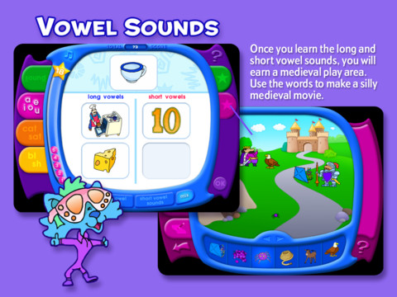
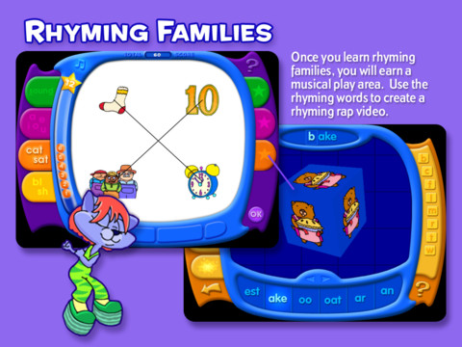
$4.99
By School Zone Publishing

Slide 110
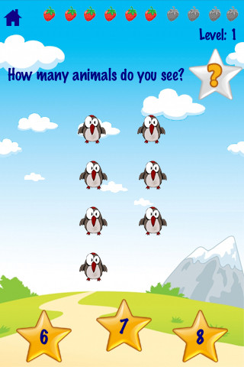
123 Animals Counting
“Teaches toddler and young kids VISUALLY and VOCALLY how to COUNT with fun animated animals and touch screen interactions.”
Touch 40 different animals with sounds to see and hear numbers counted.
Good for children with auditory impairments or who require novelty in learning.

Slide 111
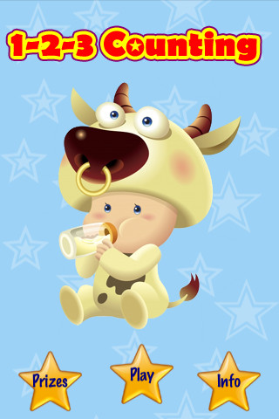
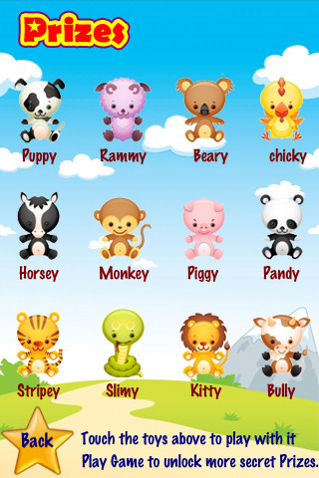
$1.99
By Brain Counts

Slide 112
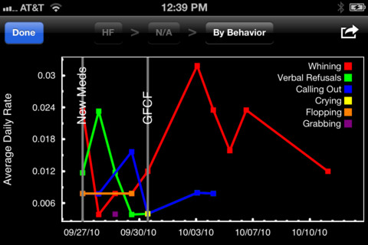
Behavior Tracker Pro
“Behavior Tracker Pro for Autism is an iPhone, iTouch and iPad application that allows BCBAs, behavioral therapists, aides, teachers or parents to track behaviors.”
This app can be used to track ABC data, frequency and duration, and high frequency data, and automatically graph them.

Slide 113
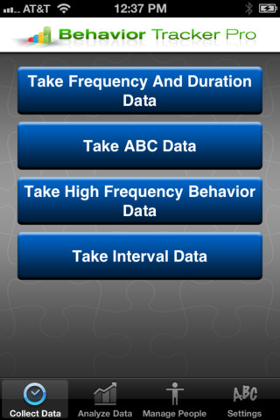
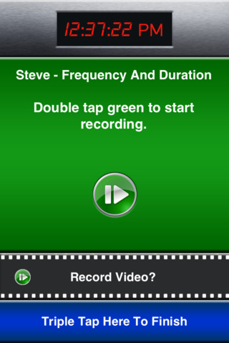
$29.99
By Marz Consulting Inc.

Slide 114
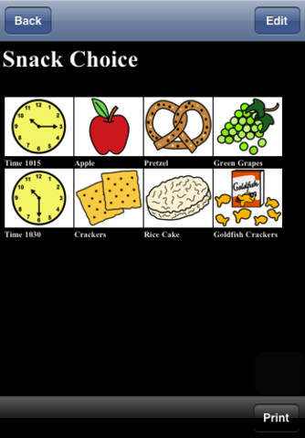
iCommunicate
“iCommunicate lets you design visual schedules, storyboards, communication boards, routines, flash cards, choice boards, speech cards, and more. It is customizable to your needs.“
In the app iCommunicate, pre-loaded pictures and storyboards/routines (e.g.,
schedule) facilitate language comprehension and enhance communication.

Slide 115
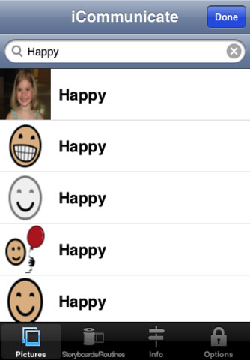

$49.99
By Grembe Inc.

Slide 116

Proloquo2Go
“Proloquo2Go™ is an award-winning Augmentative and Alternative Communication (AAC) solution for iPad, iPhone and iPod touch for people who have difficulty speaking or cannot speak at all.”
Great for students with communication disorders, including children on the autism spectrum.

Slide 117


$189.99
By AssistiveWare

Slide 118


Slide 119
A NATURAL OUTCOME
The interesting part about accommodating lessons for students with Autism is that ALL students can benefit by the use of technology when teaching a lesson. It is more work. It also is a very effective way to teach that will increase learning for all students.

